Slide 1
3 Application of FEM in Geotechniques using FE based software
3.1 Deformation Analysis
Deformations as a result of earthworks
Foundations
Embankments (road, dam)
Slopes (Man-made & Natural)
Excavations
Tunnels

Slide 2
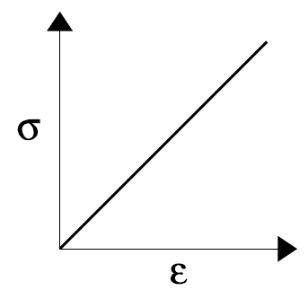
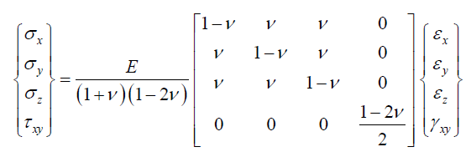
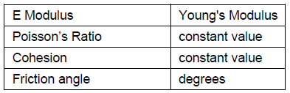
Stress Analysis
Constitutive Models
Linear Elastic

Slide 3
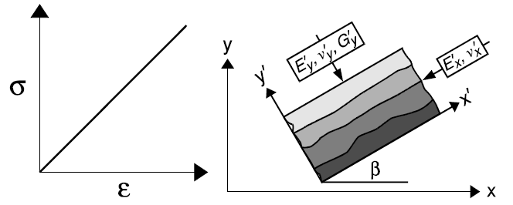
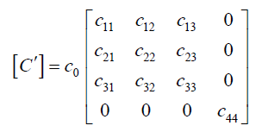
Anisostropic Linear Elastic
Constitutive matrix in local coordinate system

Slide 4
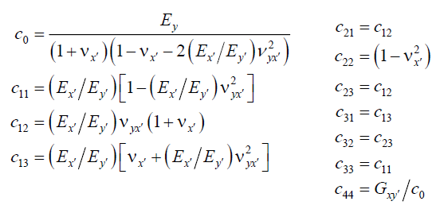

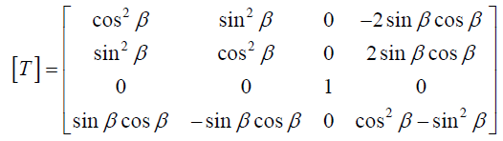
Anisostropic Linear Elastic
Constitutive matrix in global coor.

Slide 5
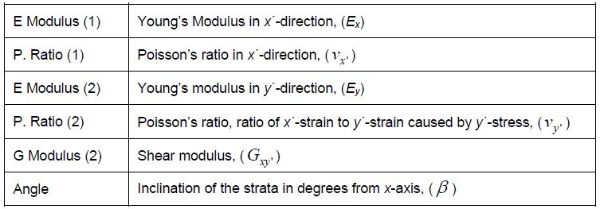
Anisostropic Linear Elastic

Slide 6
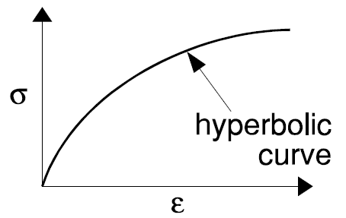


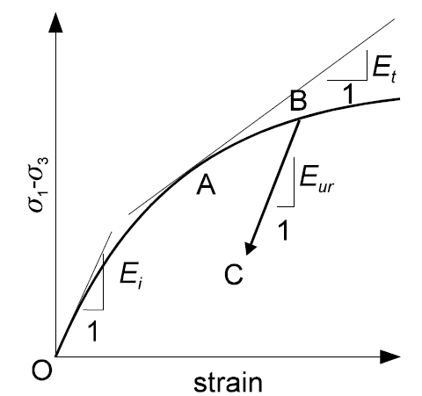




Nonlinear Elastic (Hyperbolic)
R_{f} is ratio of asympt value to
max shear strength value (0.75-1)

Slide 7




Nonlinear Elastic
Yield Criterion:
Duncan and Chang relationship:
Mohr‘s diagram:
Using above eqn:

Slide 8
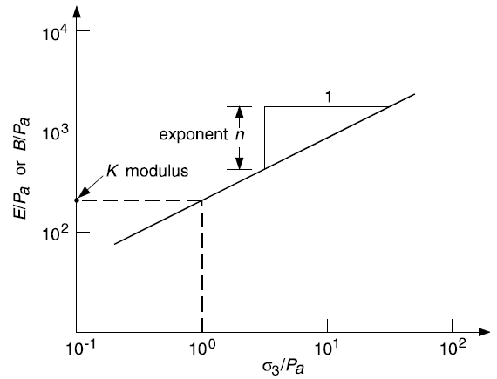

Nonlinear Elastic
Parameter determination

Slide 9
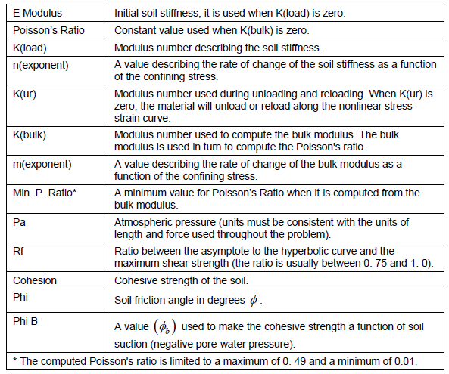
Parameter determination for nonlinear elastic model

Slide 10
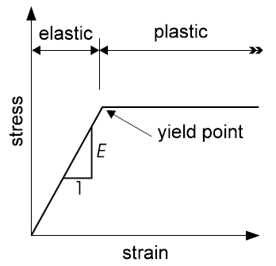




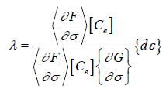

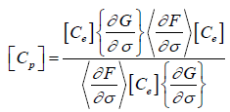

Elastic-plastic

Slide 11



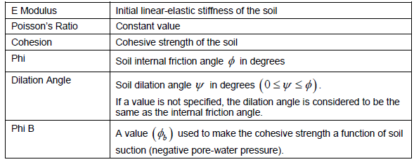

Slide 12
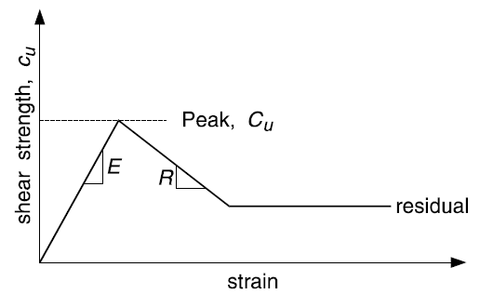
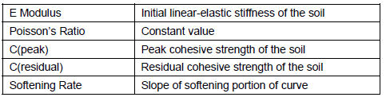
Strain-softening

Slide 13
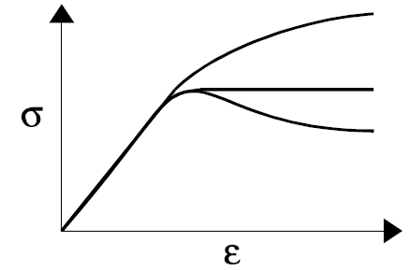
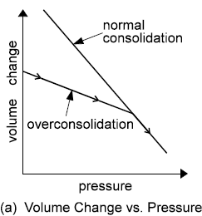
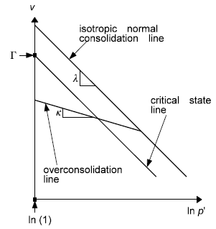
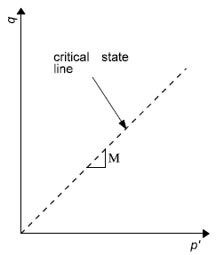
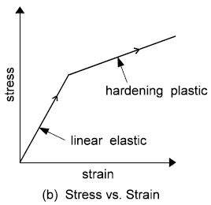



Cam-clay (Modified Cam-clay)

Slide 14
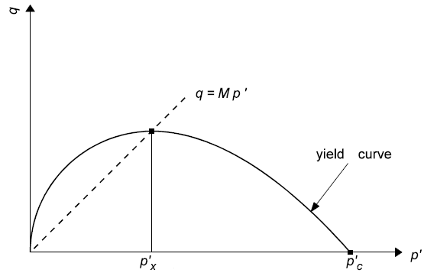
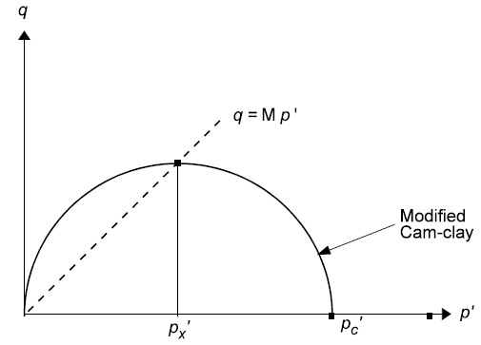
Cam-clay Constit Model
Modified Cam-clay Const

Slide 15

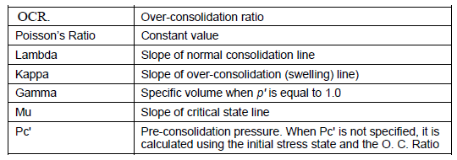
Modified/Cam-clay Constit Model

Slide 16
7 Finite Difference Method
7.1 Introduction
In FDM derivatives in the governing equations are written in finite difference equations.
The solutions are computed at specific - discrete – points called Nodes.
The process of subdividing the domain into discrete points is called discretization.
Starting from x=0 the domain is subdivided in steps, until x=1. The chosen step is called step size and is denoted by Δx.

Slide 17
7 Finite Difference Method
Consider the second-order, one-dimensional differential equation
With Dirichlet boundary conditions (values of variable u specified at boundaries):
Exact Solution:
In FDM, solutions are computed at specific - discrete – points called Nodes.

Slide 18
7 Finite Difference Method ... Cont‘d
Forward difference

Slide 19
7 Finite Difference Method ... Cont‘d
Backward difference
Central difference

Slide 20
7 Finite Difference Method ... Cont‘d
Therefore:
Given Boundary condition: u_{i-1}=0, u_{i+1}=0; and at point i, Δx = 1/2
From Exact Solution:

Slide 21
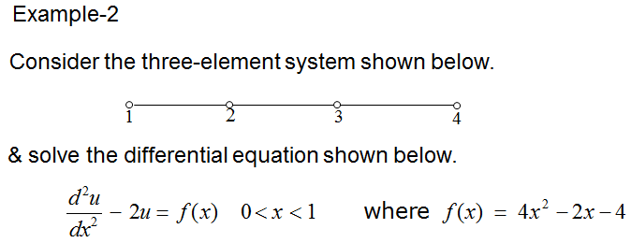
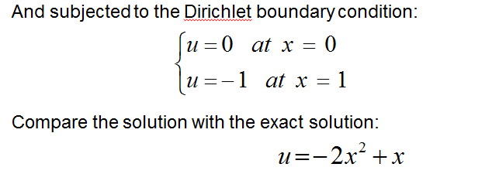
7 Finite Difference Method ... Cont‘d

Slide 22
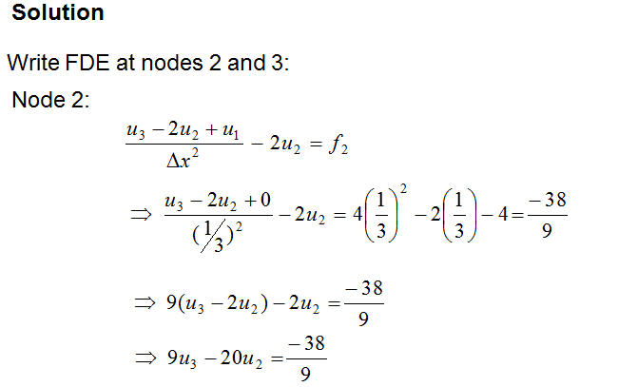
7 Finite Difference Method ... Cont‘d

Slide 23
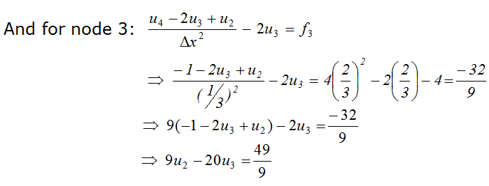
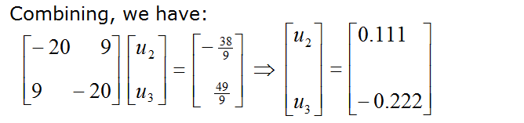
7 Finite Difference Method ... Cont‘d

Slide 24
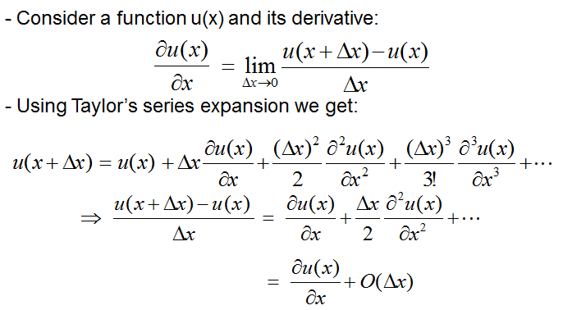
7 Finite Difference Method ... Cont‘d
4.2 Derivation of Finite Difference Equations

Slide 25
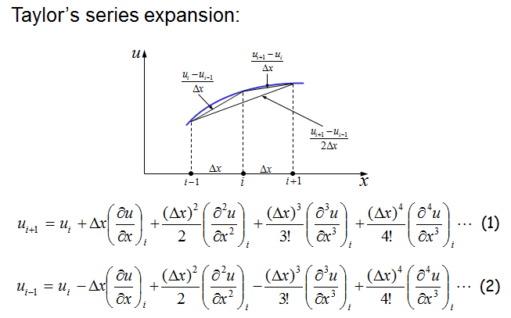
7 Finite Difference Method ... Cont‘d

Slide 26
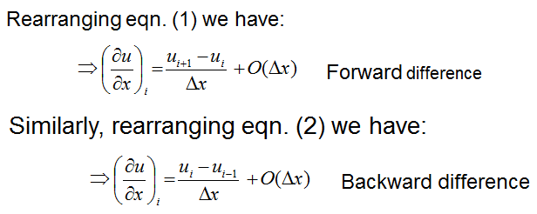
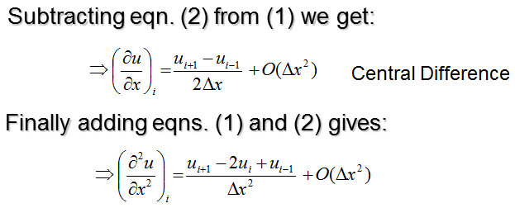
7 Finite Difference Method ... Cont‘d

Slide 27
7 Finite Difference Method ... Cont‘d
7.3 FD Solution of Terzaghi’s 1D Consolidation Equation
Govering 1D consolidation equation
Recall what are !

Slide 28
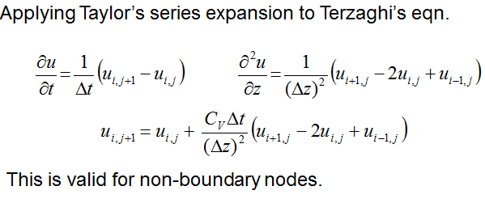

7 Finite Difference Method ... Cont‘d

Slide 29
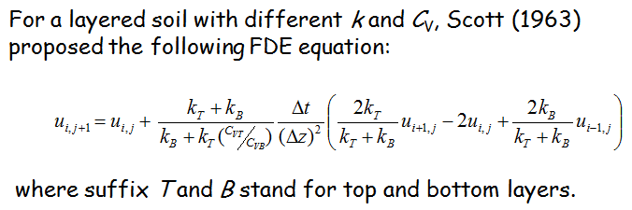
7 Finite Difference Method ... Cont‘d

Slide 30
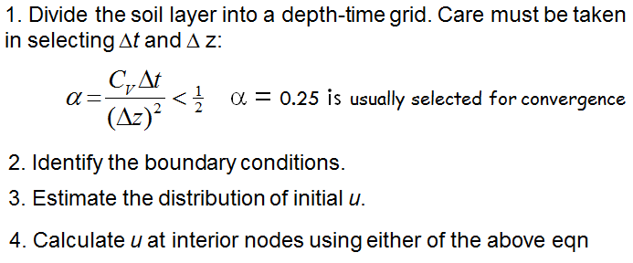
7 Finite Difference Method ... Cont‘d
Procedure of application of FDM for 1D consolidatioin problem

Slide 31
7 Finite Difference Method ... Cont‘d
Procedure of application of FDM for 1D consolidatioin problem

Slide 32
7.4 FD Solution of Consolidation Settlement & Average Degree of Consolidation
Consolidation is a type of fluid/solid interaction process.
A slow dissipation of pore pressure causes displacements to occur in the soil.
This type of behavior involves two mechanical effects:
Changes in pore pressure cause changes in effective stress, which affect the response of the solid (for example, a reduction in effective stress may induce plastic yield).
The fluid in a zone reacts to mechanical volume changes by a change in pore pressure.
Coupling between fluid and mechanical phenomenon due to deformable grains is provided through the Biot coefficient, α.

Slide 33

7.4 FD Solution of Consolidation Settlement & Average Degree of Consolidation
The Biot coefficient, α, is defined as the ratio of the fluid volume gained (or lost) in a material element to the volume change of that element when the pore pressure is changed.
It can be determined in the same drained test as that used to determine the drained bulk modulus, K, of the material.
Its range of variation is between 3n/(2+n) and 1, where n is the porosity.

Slide 34
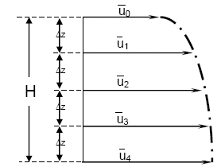
7.4 FD Solution of Consolidation Settlement & Average Degree of Consolidation

Slide 35
7.5 FD Solutions of Laplace’s equation (2D Flow)
The Laplacian equation :
The essence of the method consists of approximating the partial derivative of flow given above by finite difference quotients.
Let us assume the domain is covered by a mesh of rectangles of sides Δx, Δz.
By using the Taylor’s series expansion for the hydraulic gradient h(x), the hydraulic head at the nodal points can be expressed as:

Slide 36
7.5 FD Solutions of Laplace’s equation (2D Flow)

Slide 37



7.6.1 General Description
The mechanics of the medium are derived from general principles (definition of strain, laws of motion), and the use of constitutive equations defining the idealized material.
The resulting mathematical expression is a set of partial differential equations, relating mechanical (stress) and kinematic (strain rate, velocity) variables, which are to be solved for particular geometries and properties, given specific boundary and initial conditions.
Strain rate tensor:
Instant. Rigid-body displ
Rotation tensor

Slide 38
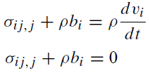

7.6.1 General Description … Cont’d
Develop the Cauchy‘s equations of motion and equilibrium:
Apply the constitutive equation

Slide 39
7.6.2 Numerical Formulation
The finite difference approach for 3D problem:
Bases on the idea that the first-order space and time derivatives of a variable are approximated by finite differences assuming linear variations of the variable over finite space and time intervals, respectively.
The continuous medium is replaced by a discrete equivalent—one in which all forces involved (applied and interactive) are concentrated at the nodes of a three-dimensional mesh used in the medium representation
The laws of motion for the continuum are transformed into discrete forms of Newton’s law at the nodes. The resulting system of ordinary differential equations is then solved numerically (implicit/ explicit finite difference approach in time).

Slide 40
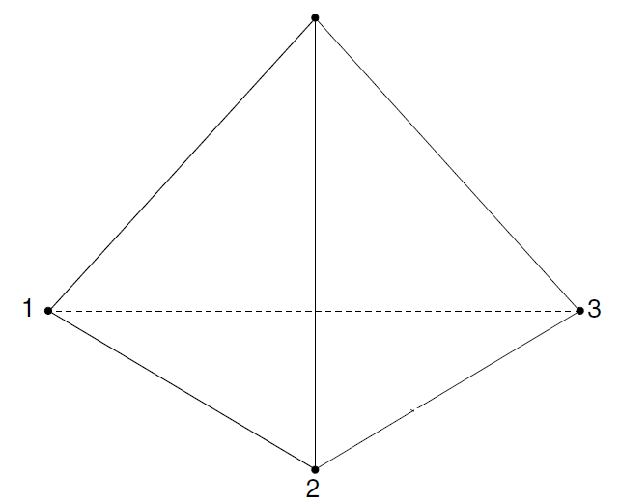
7.6.2 Numerical Formulation … Cont’d
The spatial derivatives involved in the derivation of the equivalent medium are those appearing in the definition of strain rates in term of velocities.
For the purpose of defining velocity variations and corresponding space intervals, the medium is discretized into constant strain-rate elements of tetrahedral shape whose vertices are the nodes of the mesh mentioned above.
A tetrahedron is represented below

Slide 41
7.6.2 Numerical Formulation … Cont’d
Body Discretization
Initial and Boundary Conditions
The boundary conditions of the problem consist of surface tractions, concentrated loads and displacements.
In addition, body forces may be given and initial stress conditions imposed.
Loading
Nodal load

Slide 42
8 Application of FDM in Geotechniques using FD based software
Deformation Analysis
Embankment/excavation construction
Excess pore-water pressures
Soil-structure interaction
Consolidation analyses
Seepage analysis

Slide 43
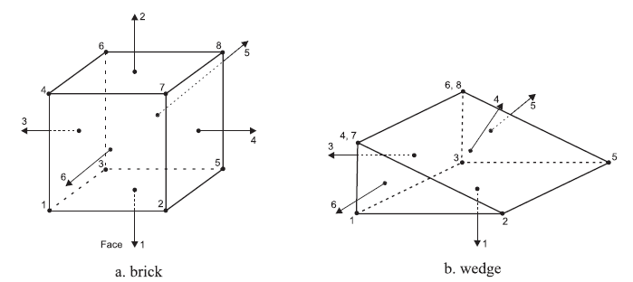
8 Application of FDM … Cont’d
FLAC 3D
ZONE (ELEMENT)- The finite difference zone is the smallest geometric domain within which the change in a phenomenon (e.g., stress versus strain) is evaluated.
Polyhedral zones of different shapes (e.g.brick, wedge, pyramid and tetrahedral-shaped zones) are used to create models, and can be viewed upon plotting.

Slide 44
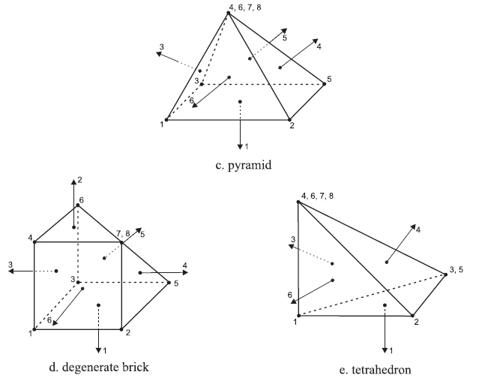
8 Application of FDM … Cont’d
.

Slide 45
8 Application of FDM in … Cont’d
GRIDPOINT — Gridpoints are associated with the corners of the finite difference zones. There are five, six, seven or eight gridpoints associated with each polyhedral zone, depending on the zone shape.
FINITE DIFFERENCE GRID — The finite difference grid is an assemblage of one or more finite difference zones across the physical region that is being analyzed. Another term for grid is mesh.

Slide 46
8 Application of FDM … Cont’d
MODEL BOUNDARY—The model boundary is the periphery of the finite difference grid.
BOUNDARY CONDITION—A boundary condition is the prescription of a constraint or controlled condition along a model boundary.
INITIAL CONDITIONS — This is the state of all variables in the model (e.g., stresses or pore pressures) prior to any loading change or disturbance (e.g., excavation).
CONSTITUTIVE MODEL — The constitutive (or material) model represents the deformation and strength behavior prescribed to the zones in a FLAC3D model.

Slide 47
8 Application of FDM … Cont’d
NULL ZONE — Null zones are zones that represent voids.
SUB-GRID —
ATTACHED FACES — Attached faces are grid faces of separated sub-grids that are attached or joined together.
INTERFACE — An interface is a connection between sub-grids that can separate (e.g., slide or open) during the calculation process. An interface can represent a physical discontinuity such as a fault, contact plane, or interface between two different materials.
RANGE — A range in a FLAC3D model is a description of a specific volume of space.

Slide 48
8 Application of FDM … Cont’d
GROUP—A group in a FLAC3D model refers to a collection of zones identified by a unique name.
ID NUMBER — Individual elements of a FLAC3D model are identified by identification (ID) numbers.
The PRINT command is used to obtain the ID numbers. ID numbers can be assigned by the user to interfaces, structural element entities, reference points, histories, tables and plot items.
Component identification (CID) numbers are also assigned to individual elements of a structural element entity.

Slide 49
8 Application of FDM … Cont’d
STRUCTURAL ELEMENT — Two types of structural element are available in FLAC3D.
Two-noded & three-noded
STEP—Because FLAC3D is an explicit code, the solution to a problem requires a number of computational steps.
Typical problems are solved within 2000 to 4000 steps, although large complex problems can require tens of thousands of steps to reach a steady state.
STATIC SOLUTION — A static or steady-state solution is reached in FLAC3D when the rate of change of kinetic energy in a model approaches a negligible value.

Slide 50
8 Application of FDM … Cont’d
UNBALANCED FORCE—The unbalanced force indicates when a mechanical equilibrium state (or the onset of plastic flow) is reached for a static analysis.
DYNAMIC SOLUTION—For a dynamic solution, the full dynamic equations of motion (including inertial terms) are solved;
LARGE STRAIN/SMALL STRAIN

Slide 51
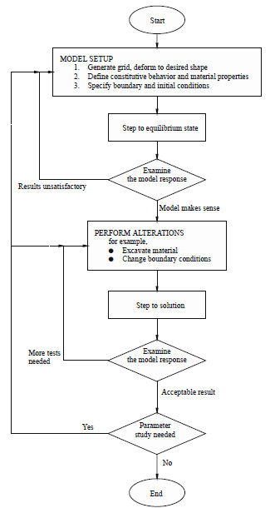

Slide 52
8 Application of FDM … Cont’d
Example Problems
Deformation Analysis
Embankment/excavation construction
Excess pore-water pressures
Soil-structure interaction
Consolidation analyses
Seepage analysis

